Slide 1


Treatment Capacity in Illinois
Commission on Criminal Justice and Sentencing Reform
Wednesday, June 3rd, 2015
1:00pm to 5:00pm

Slide 2

Introduction
What is the treatment capacity in Illinois?
For mental health?
For substance abuse?
For forensic population?
Where are the resources located?
What are the data limitations?

Slide 3
Mental Health Treatment Capacity

Slide 4
Mental Health Treatment Numbers in Illinois
Private Hospitals
State Hospitals
113,781 admissions
to 3,481 beds in 2010
8,586 admissions to 1,324 beds in FY2012
Incarceration (Jails)
Incarceration (Prisons)
1,400 of the 9,600 inmates in Cook County Jail receive DMH-Funded psychiatric services
11,300 with mental illness needs in FY2012
Private Community-Based
State Community-Based
Currently researching for additional data
136,047 receiving treatment in FY2012
Source: Illinois Department of Human Services, Illinois Mental Health 2013-2018 Strategic Plan; Dr. Anderson Freeman and DMH staff.

Slide 5
Illinois Mental Health Facilities by Type
512 Respondents
Source: SPAC analysis of N-MHSS data, SAMHSA, 2010.

Slide 6
Civil admissions and presentations (sent to hospital, may not end in admission), as well as total served, are down almost 40%.
Source: SPAC analysis of figures provided by Dr. Anderson Freeman and DMH staff.

Slide 7
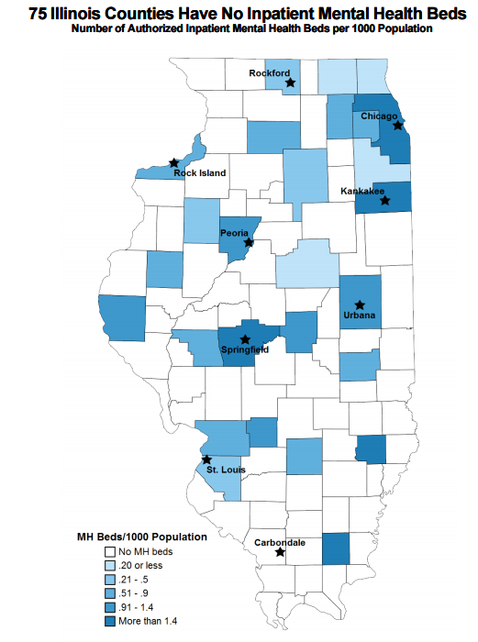
Illinois has 222 hospitals spanning 80 counties in Illinois.
22 counties do NOT have a hospital.
80 hospitals have authorized psychiatric beds, for a total of 3,927 authorized psychiatric beds.
52 counties do NOT have authorized psychiatric hospital beds.
28 counties have inpatient behavioral health providers.
75 counties do NOT have inpatient behavioral health providers .
Over half of Illinois counties lack sufficient numbers of psychiatrists.
Source: Illinois Hospital Association, Facts & Figures, 2015.

Slide 8
Special Programs in Illinois
Mental Health Facilities
Source: SPAC analysis of N-MHSS data, SAMHSA, 2010.

Slide 9
Substance Abuse Treatment Capacity

Slide 10
Admissions of Chicago Residents to Publicly Funded Treatment Programs, by Primary Substance: FY2007 – FY2012
Largest reduction: cocaine 66%
Source: Dr. Larry Ouellet of UIC, data from the Illinois Department of Alcohol and Substance Abuse

Slide 11
Declining Admissions for Substance Abuse
The number served declined over 21% since 2003.
Declining admissions do not mean declining need.
Source: Illinois Auditor General DHS Financial Audits.

Slide 12
Source: N-SSATS Illinois State Profile, SAMHSA, 2002-2011.

Slide 13
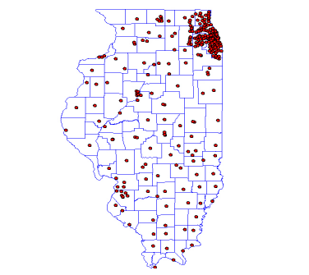
Geographic Distribution of Substance Abuse Treatment Facilities In Illinois
11 counties had no one respond to the survey.
638 facilities responded to a survey by the National Survey of Substance Abuse Treatment Services Survey (N-SSATS) out of 663 surveyed.
Each red dot on the map represents one responding facility.
Source: N-SSATS Illinois State Profile, SAMHSA, 2011.

Slide 14
Source: N-SSATS Illinois State Profile, SAMHSA, 2002-2011.

Slide 15
Source: N-SSATS Illinois State Profile, SAMHSA, 2002-2011.

Slide 16
Treatment rate provides a metric to compare between states.
Calculated by dividing the total number receiving treatment by the state population.
Source: N-SSATS Illinois State Profile, SAMHSA, 2002-2011.

Slide 17
Treatment Rate Comparison With Regional States
Source: N-SSATS Illinois State Profile, SAMHSA, 2002-2011.

Slide 18
Forensic Population

Slide 19
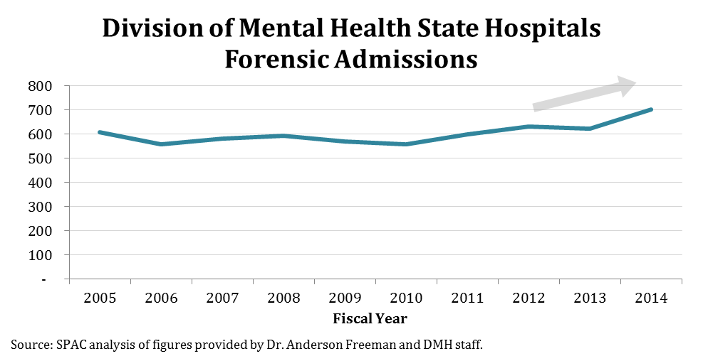
Forensic admissions to state mental health hospitals have increased 15% since 2005.
These admissions are for those found Unfit to Stand Trial (UST) or Not Guilty by Reason of Insanity (NGRI), and nearly 20% are for misdemeanor offenses.
Waiting list for admission is 80+ persons, with wait times 30 to 40 days.
Source: SPAC analysis of figures provided by Dr. Anderson Freeman and DMH staff.

Slide 20
Source: N-SSATS Illinois State Profile, SAMHSA, 2002-2011.

Slide 21
Forensic Programs in
Illinois Mental Health Facilities
Source: SPAC analysis of N-MHSS data, SAMHSA, 2010.

Slide 22
Impact of Reduction

Slide 23
Impact on Mental Health Capacity
The Bureau of Justice Statistics estimates that 55% of male inmates and 73% of female inmates have mental health needs. Applying this estimate to the reduction goal of 12,000 means an additional 7,000 individuals accessing mental health treatment in the community.
That is a 5% increase over 2014 numbers.
Source: SPAC analysis of figures provided by Dr. Anderson Freeman and DMH staff.

Slide 24
Impact on Substance Abuse Capacity
The Centers for Disease Control and Prevention estimates that 80% of inmates have substance abuse problems. Applying that to the reduction goal would mean 9,600 individuals will have substance abuse issues and will need community-based treatment.
That is a 21% increase in population served.
Source: N-SSATS Illinois State Profile, SAMHSA, 2002-2011.

Slide 25
Funding

Slide 26
State appropriations
to DHS has decreased 39% since 1998.
Funding for DMH has decreased 10% since FY2005.
Source: SPAC analysis of figures provided by Dr. Anderson Freeman and DMH staff; Illinois Auditor General DHS Financial Audits

Slide 27
Primary Funding Source in Illinois Mental Health Facilities
512 Facilities Surveyed in Illinois
Of 442 responses, 306 (69%) had one primary funding source that made up over half of their overall revenue.
Source: SPAC analysis of N-MHSS data, SAMHSA, 2010.

Slide 28
General Sources
This information is specific to the state of Illinois.
Information was gathered from:
Special thanks to Dr. Anderson Freeman and his staff at the Division of Mental Health for their data on funding and numbers served.
Illinois Auditor General Financial Audits on Department of Human Services.
the National Survey of Substance Abuse Treatment Services (N-SSATS) Survey. This annual survey collects information on all substance abuse facilities, including both alcohol and drug abuse, and in facilities private and public. They produce state profiles of their findings for 2002 through 2011, available on their website.
the National Mental Health Services Survey (N-MHSS). Surveys all mental health facilities in US, both private and public, available for 2010.
Both surveys are conducted by Substance Abuse and Mental Health Services Administration (SAMHSA).
University of Illinois at Chicago (UIC) School of Public Health professor Larry Ouellette prepared the analysis of Illinois’ publicly-funded admissions for substance abuse.
Illinois Hospital Association tallies the number of hospitals, authorized beds, and behavioral health providers by county across the state of Illinois.
Other figures gathered from various sources such as the National Alliance on Mental Illness (NAMI), Illinois Department of Health Services, and Illinois Department of Public Health (Center for Rural Health).

Slide 29
References
Slide 4: Illinois Department of Human Services, Illinois Mental Health 2013-2018 Strategic Plan. Available at: https://www.dhs.state.il.us/onenetlibrary/27897/documents/mental%20health/marysmith/strategicplan/mentalhealthservicesfiveyearstrategicplan2013.pdf, p.3 of Appendix B.
Slide 7: Illinois Hospital Association. (2015). Facts & Figures. Available at: http://www.ihatoday.org/News-and-Reports/Facts-and-Figures/Maps.aspx
Slide 7 map: Generated by IHA COMPdata informatics (April 02, 2014). Available at: http://www.ihatoday.org/uploadDocs/1/bhcountymap.pdf
Slide 8: Estimate of comorbidity: National Institute on Drug Abuse. (2010). Comorbidity: Addiction and Other Mental Illnesses. Research Report Series. Available at https://www.drugabuse.gov/sites/default/files/rrcomorbidity.pdf
Slides 8-9: Substance Abuse and Mental Health Services Administration (SAMHSA). (2010). National Mental Health Services Survey (N-MHSS). Available at: http://www.icpsr.umich.edu/icpsrweb/SAMHDA/studies/34945#datasetsSection
Slide 12: Graph created by Dr. Larry Ouellet of UIC, with data from the Illinois Department of Alcohol and Substance Abuse.
Slides 13-17: Substance Abuse and Mental Health Services Administration (SAMHSA). (2002-2011). National Survey of Substance Abuse Treatment Services (N-SSATS) State Profiles. Available at: http://wwwdasis.samhsa.gov/webt/tedsweb/tab_year.choose_year_state_profile?t_state=IL
Slide 23: Estimate of mental health issues: Glaze, L.E. & James, D.J. (2006). Mental Health Problems of Prison and Jail Inmates. Bureau of Justice Statistics Special Report. Available at http://www.bjs.gov/index.cfm?ty=pbdetail&iid=789.
Slide 24: Estimate of 80% with substance abuse issues from CDC report. U.S. Centers for Disease Control and Prevention, Substance Abuse Treatment for Drug Users in the Criminal Justice System, (Aug. 2001), available at: http://www.cdc.gov/idu/facts/cj-satreat.pdf

